Slide 1
Account Management Microservice - A QuickStart

Slide 2
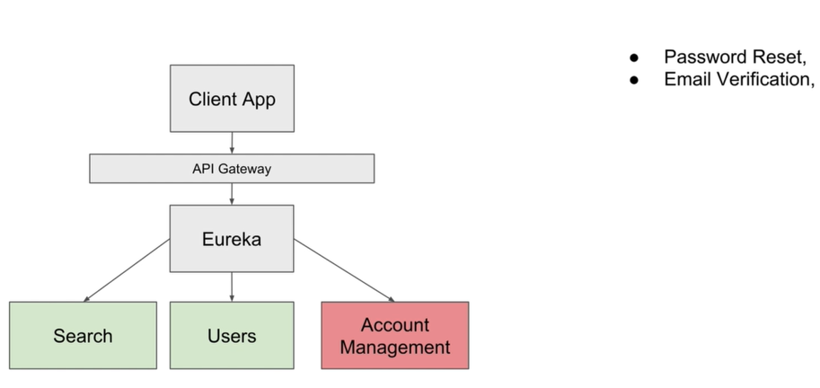

Slide 3
Password Reset - Create a new Spring Boot Project

Slide 4
